Slide 1
Lesson 12 – Shopping
Today’s lesson is all about shopping – let’s begin by learning about the different
types of stores.
At a supermarket or grocery store, you can buy food as well as things for your house, like cleaning supplies.
At a bakery, you can buy bread, cakes, pies, pastries, muffins, and cupcakes.
At a delicatessen or deli, you can buy cheese, sliced meat for sandwiches, salads, and other prepared food that is ready to eat.
At a pharmacy or drugstore, you can buy medicine, band-aids, eye drops, and other personal care items.
At a florist, you can buy a bouquet of flowers.
At a jewelry store or jeweler, you can buy necklaces, bracelets, earrings, and rings.
At a pet shop, you can buy animals like puppies, kittens, rabbits, fish, or birds. Pet shops also sell accessories like these: collar, leash, cage, tank, bowl, toys.
At a bookshop or bookstore, you can buy books and sometimes magazines or newspapers.
At a hardware store, you can buy things for construction or fixing things around the house – like tools, paint, plumbing supplies, and electrical supplies.
A department store is a large store with many different areas – for example, clothes, electronics, food, toys, items for the house, etc.
A mall or shopping center is a large building that contains many different stores, usually including a food court with many different restaurants.
A convenience store or corner store is a small store that contains some basic snacks, drinks, and supplies. Many gas stations have a convenience store, for example.

Slide 2
Other types of stores are often identified by the items they sell – a toy store sells toys, a shoe store sells shoes, etc.
Let’s focus on two common situations: shopping for clothes and shopping at the
supermarket.
Conversation #1 – Shopping for clothes
Saleswoman: Do you need any help?
Fred: Yes, I’m looking for polo shirts.
Saleswoman: OK, we have a few different styles – this one’s more dressy, and this
one’s more casual.
(dressy = formal)
Fred: Can I try these on?
Saleswoman: Sure – the fitting rooms are right over there.
(he tries on the shirts)
Saleswoman: How were they?
Fred: I like this casual shirt, but it’s too loose. Do you have it in a smaller size?
Saleswoman: Let me check… yes, we do! Here’s a medium.
(he tries on the medium shirt)
Saleswoman: Was it OK?
Fred: It fits perfectly! But do you have it in green instead of blue? Saleswoman: One moment… here’s a dark green and a light green. Fred: I like the dark green one. How much is it?
Saleswoman: Normally $39.95, but it’s on sale for $29.95.

Slide 3
Fred: I’ll take it.
Conversation Vocabulary & Phrases
When you go into a store, a salesperson might ask:
“Can I help you?”
“Do you need any help?”
To say “no,” you can respond:
“No thanks. I’m just looking.”
“No thanks. I’m just browsing.”
The word “browsing” means to look through many items in a casual way.
If you want to say “yes,” you can respond, “Yes, I’m looking for…” and then name the item you want to buy. For example,
“Yes, I’m looking for… a white dress.”
“Yes, I’m looking for… a jacket for my son.”
If you need help finding an item in the store, you can ask a salesperson:
"Excuse me, where can I find… children’s clothing?"
"Excuse me, do you have any… workout clothes?"
Let’s say you find a piece of clothing you like – but you want to put on the clothing to
see if it’s the right size. You can ask the salesperson:
“Can I try it on?”
“Where are the fitting rooms / try-on rooms?”
If the clothing is too big, you can say:
“It’s too loose. Do you have this in a smaller size?”
If the clothing is too small, you can say:
“It’s too tight. Do you have this in a larger size?”

Slide 4
And if the size of the clothing is correct, then you can say:
“It fits perfectly!”
Sometimes the size is correct, but it just doesn’t look good on you. In this case, you
can say:
“It’s not my color.”
“It’s not my style.”
The phrase “I’ll take it!” means you are going to buy the item.
Conversation #2 – Returning an Item
Fred bought a jacket, too, but then discovered a defect. Listen to this conversation as he goes back to the store to return the jacket.
Fred: Hi there. I bought this jacket earlier today, but when I got home I found out that it has a hole in the sleeve. Can I exchange it for another one?
Assistant: Mmm-hmm. Do you have the receipt?
Fred: Yes – here you go.
Assistant: Oh, I’m so sorry, but we don’t have any more of that model. Would you prefer to receive a refund or store credit?
Fred: A refund.
If you need to return an item you bought to the store, always bring the receipt
that's the piece of paper you received when you bought the item. It's also good if the clothing still has its original tags - the tag is the piece of paper attached to the clothing that has the price and the bar code.
When you return an item, many stores will offer you two or three options:
You can exchange the item for another one. This is usually done if you discover that the item is defective (there is some problem with the item).

Slide 5
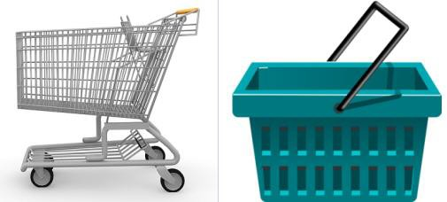
You can get a refund - that means you get your money back.
Sometimes, you can get store credit - that means you get the price of the returned item discounted from the next purchase you make in the store, in the future.
Conversation #3 – Shopping at a Supermarket
When you go into the supermarket, you’ll take a shopping cart – or a basket if you only want to buy a few things.
Let’s look at a conversation with an employee of the store:
Barbara: Excuse me - where can I find the mayonnaise?
Employee: It's on aisle 12.
Barbara: OK, thanks. And do you have any non-fat yogurt?
Employee: Yes, in the dairy section.
Barbara: Right. One more thing - I couldn't find any whole wheat pasta.
Employee: Sorry - we're out of it. You can check back on Monday.
Barbara: Oh, okay. What about sunflower seeds?
Employee: Ah, we don't carry sunflower seeds. You might try the natural foods store across the street.
Barbara: All right. By the way, are these boxes of cereal on sale?
Employee: Yup - they're buy one, get one free.
Barbara: Great!

Slide 6
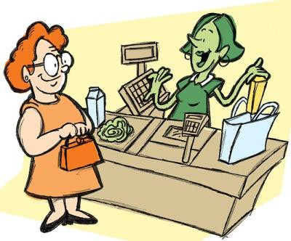
(at the checkout)
Cashier: Do you have a loyalty card?
Barbara: No.
Cashier: Would you like to join our loyalty program? You’ll get an instant 10% off
this purchase.
Barbara: No thanks – maybe another time. I’m in a bit of a hurry today. Oh – that reminds me, I have a coupon for half-price on these canned soups.
Cashier: All right. It comes to $152.74. How would you like to pay?
Barbara: Do you take credit cards?
Cashier: Yes, we do.
Barbara: Here you go.
Cashier: Please sign here... and here's your receipt. Have a nice day!
Barbara: Thanks, you too!
Conversation Vocabulary & Phrases
To ask an employee of the store for help, you can say:
“Where can I find... the mayonnaise?”

Slide 7
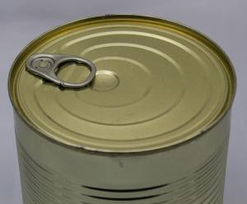
“Do you have... any non-fat yogurt?”
The employee might refer you to an aisle – aisles are the corridors in the supermarket. Or they might tell you to go to one of these sections of the store:
Dairy section – Milk, yogurt, butter, and cheese
Produce section – Fresh fruits and vegetables
Frozen food section – Ice cream, pre-prepared meals
Bakery – Bread, muffins, cakes
Deli – Sliced meat and cheese for sandwiches
Ethnic foods section – International and imported foods
If the store doesn’t have the item, the employee will say:
“Sorry, it’s out of stock / we’re out of it at the moment.”
(the item is temporarily unavailable)
“Sorry, we don’t carry mango juice.”
(we don’t carry = the store never sells the item; you need to go to a different store)
You can buy food in different types of packaging:
A can of soup

Slide 8
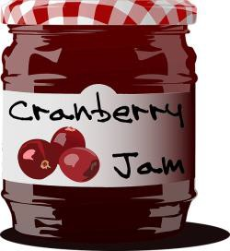
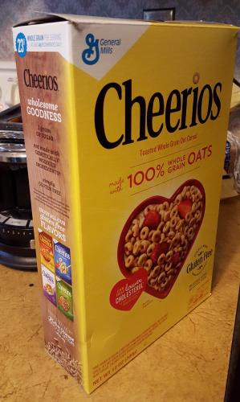
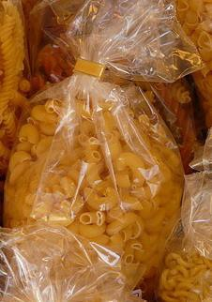
A jar of jelly / jam
A box of cereal
A package of pasta

Slide 9
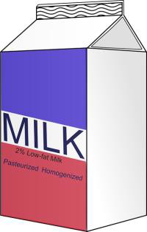
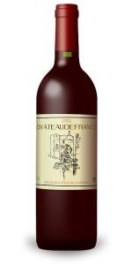
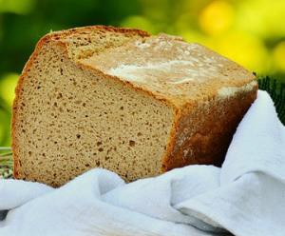
A carton of milk
A bottle of wine
A loaf of bread
Here are some phrases for talking about discounts:
“Is this on sale?”
"I have a coupon."
• "It's 20% off."
"It's buy one, get one free."
"If you buy two, you get the third one free."

Slide 10
When you’re ready to pay, go to the checkout. The person who works there is called the cashier. The cashier might say:
“How would you like to pay?”
“In cash.”
“With a credit card.”
“With a debit card.”
If you pay with a credit card, the cashier will say,
“Please sign here.”
(write your name on the paper)
If you pay with a debit card, the cashier will say,
“Please enter your PIN.”
(PIN = personal identification number)
If you pay in cash – imagine your purchases total $70 and you pay $100 in cash, the cashier will give you back the extra money ($30) and say,
“Here’s your change.”
“Your change is $30.”
Finally, the cashier will say:
"Here's your receipt."
receipt = the piece of paper with the list of what you bought
Now take the quiz to test your memory of the shopping phrases!

Slide 11
Quiz – Lesson 12
You can buy apples at the .
boutique
florist
supermarket
I have a headache. Is there a nearby?
hardware store
department store
pharmacy
You can buy toys for your dog at the .
food court
deli
pet shop
You can pick up fresh bread at the .
bakery
corner store
jeweler
He's going to the to buy a diamond ring.
hardware store
jewelry store
corner store
Let's have lunch at the .
bakery
deli
drugstore
A lot of new shops have recently opened up in the .
supermarket
department store
mall

Slide 12
I'm going to stop in the and pick up a soda.
hardware store
convenience store
pet shop
He called the and ordered a bouquet of roses.
jewelry store
mall
florist
You can buy a hammer at the _.
hardware store
toy store
bookstore
Can I help you find anything? No thanks. I'm just .
browsing
checking
watching
I like these jeans. Can I ?
fit them up
put them in
try them on
These shoes are too . They're a size 9 and I think I need an 8.5.
great
loose
tight
I got this sweater as a Christmas gift, but it's too small. Can I _ it for a larger size?
credit
exchange
refund

Slide 13
Do you have any green tea?
Sorry, it's out of - check back next week!
carry
produce
stock
Salmon is normally very expensive, but it's on this week.
coupon
discount
sale
These soups were 40% , so I bought twenty cans!
down
off
out
Here's your . Have a nice day!
receipt
receive
resale

Slide 14
Lesson 12 Quiz - Answers
1.C 2.C 3.C 4.A 5.B 6.B 7.C 8.B 9.C 10.A
11.A 12.C 13.B 14.B 15.C 16.C 17.B 18.A

